Slide 1


Pearson
FACULTY ORIEANTATION oct 2022
CENTER # 91929

Slide 2


So, What’s Are we Looking at
Illustration by Ben Wiseman
General Introduction
Programme/s Delivery
Centre’s Key Templates during the IV process
Assessment Process – Assignments – Grading
System
HNGlobal
Centre Support – documents, resources,
specification features and changes, training
Digital Filing System (DFS)
Pearson Support Hub on HTU’s website
https://www.htu.edu.jo/Pearson/index.html

Slide 3
Join the HNGlobal Community
By Creating an Account as a Tutor at
www.hnglobal.highernationals.com
Pearson Support Hub
https://www.htu.edu.jo/Pearson/index.html
HTU Centre # 91929

Slide 4







Assessment Process
Assignment
Submission
Assessment
Decisions
Grade
(P/M/D)
Feedback
=
=
Assignment
Resubmission
Capped
at
Pass
Capped
at
Pass
=
REPEAT

Slide 5
WHY CHOOSE BTEC HN
BECAUSE
It provides LEARNING OUTCOMES (LO) based curriculum and grading criteria
It provides HANDS-ON Experience for future careers
It is an opportunity for Learning by Doing
It is to become JOB-READY
It meets the requirements of the Modern World Industries
It is a Kick-Start for young peoples careers
Robust Quality Assurance Measures, Protocols and best Practuces
APMR + Annual Student Survey
Annual BTEC AWARDS

Slide 6
Approved Full Awards
BTEC HN (RQF)
Construction And The Built Environment
Engineering
Computing
HNC
8 UNITS L4
Progression GPA 2.8
HND
8 UNITS L5
HTU BSc

Slide 7
ENGAGING WITH THE EMPLOYERS
Awarding Body PEARSON
Design Qualification to Meet identified skills
Provider HTU
EMPLOYERS

Slide 8

Quality Assurance Liaison Structure
(Best Practice)
SET
PQO’s
The Internal Verification Process
Quality Nominee
Computing & Informatics (CS+IS+Cyber Security)
PQO’s
SCTBE
PQO’s
Notes:
The assignment brief must be:
fit for purpose
stretch and challenge students
reflect the key elements
enable students to achieve the learning outcomes at the highest grade.

Slide 9
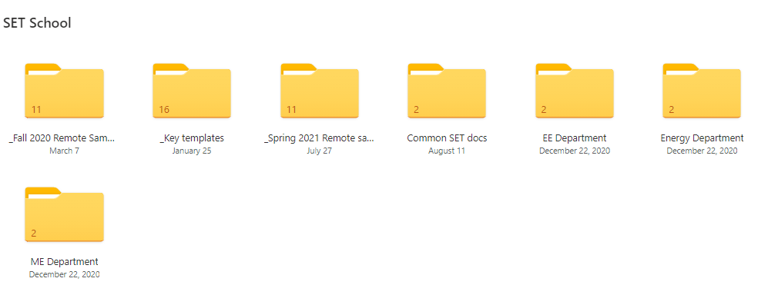
DIGITAL FILING SYSTEM (DFS)

Slide 10
Role of the External Examiner
(EE)
Pearson employs experts (External
Examiners (EEs) to work with you to
ensure standards are met.
• Your contracted EE will visit you twice per
Year
• A report will be produced after each visit
• Until one cohort of students has completed the programme the decision of the EE will be ‘Not Yet Fully Sampled’
When a cohort of students has completed a programme cycle, the EE will ‘RELEASE’ that programme for certification

Slide 11
( Key IV Templates )
Assessment Planning
Assignment Brief
Scheme of Work (SOW)
IV-Assignment Brief
IV Assignment Decision
Assignment Feedback
Student Declaration
Student Resubmission request
Discontinue Unit form
Student Appeal request
Student Assessment Record
Witness Statement
FOLLOW
THE ACADEMIC CALENDAR

Slide 12

An Assignment is:
Illustration by Ben Wiseman
An assessment tool to measure learning
Designed to allow students to demonstrate knowledge, skills and understanding.
Based on an appropriate assessment activity (e.g. report, essay, presentation, project, exam, etc.)
Based on a vocational real-life scenario or context
Notes:
The assignment brief is a written document given to students at the start of the assessment process for a unit
It can be issued as hard copy and/or online but must be kept as a record of the assessment process
The assignment is a written instruction for students to carry out a series of tasks/activities, through which they will produce evidence that will be assessed against the targeted assessment and grading criteria for a unit
As BTECs are vocational qualifications, assessment should take place within a vocational scenario or context
The design of the assignment tasks will enable students to produce works that is relevant, current, authentic, etc.

Slide 13
HOLISTIC ASSESSMENT
Holistic Assessment considers the assignment as a whole
HN assessment incorporates some academic and analytical judgement (based on assessment criteria)
Assessment criteria are not intended to be achieved through separate tasks
Assignments should be designed to allow potential achievement of all criteria ( P, M & D) through holistic activities.

Slide 14

Unit Grading
The Mastery Model is based on the principle that a student must achieve ‘mastery’ of prerequisite knowledge or skill
To achieve at a level the student must achieve everything at that level and below.
 |  | Assessment Criteria
 |  | Pass | Merit | Distinction
Grade | Pass | X
 | Merit | X | X
 | Distinction | X | X | X
Illustration by Tang Yau Hoong
Notes:
Review of mastery model of assessment. Use quiz on next slide to discuss the achievement of unit grades. Stress the fact that the lowest achievement in a single learning outcome will set the overall unit achievement. This is not new. This has been the assessment model for HNs for some time.

Slide 15
What is a grade?
Pass
(LO example- Explain)
Merit
(LO example- Analyze)
Distinction
(LO example create/construct)
hhhStudents who do not satisfy the PASS CRITERIA should be reported as UNCLASSIFIED = U

Slide 16
Grading Mechanism
Pass | Merit | Distinction
P1 | M1 | D1
P2 | M2 | D2
P3 | M3
P4 | M4
P5
5/5 need to be covered to score a P | 9/9 need to be covered to score an M | 12/12 need to be covered to score a D
* In case of scoring a U, a student can apply for a resubmission. After resubmission, the maximum grade the student can score is a P.

Slide 17
The Unit Assignment Brief
Learning Outcomes
Vocational Life-related Scenario
Assignment Brief
Assessment Criteria
Level
Notes:
The assignment brief must be:
fit for purpose
stretch and challenge students
reflect the key elements
enable students to achieve the learning outcomes at the highest grade.

Slide 18
Assessment Process
Assessment
Decisions
Grade
(P/M/D)
Assignment
Submission
Feedback
=

Slide 19
Assessment Process
Assignment
Submission
Assessment
Decisions
Grade
(P/M/D)
Feedback
=
=
Assignment
Resubmission
Capped
at
Pass

Slide 20
Assessment Process
Assignment
Submission
Assessment
Decisions
Grade
(P/M/D)
Feedback
=
=
Assignment
Resubmission
Capped
at
Pass
Capped
at
Pass
=
REPEAT

Slide 21
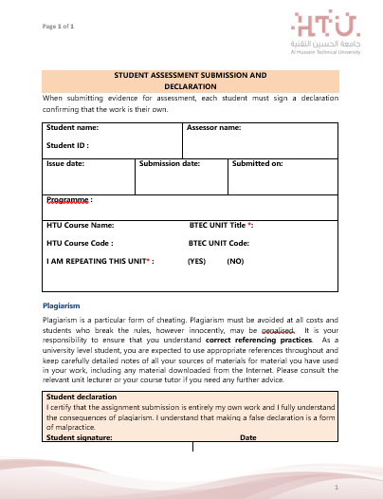
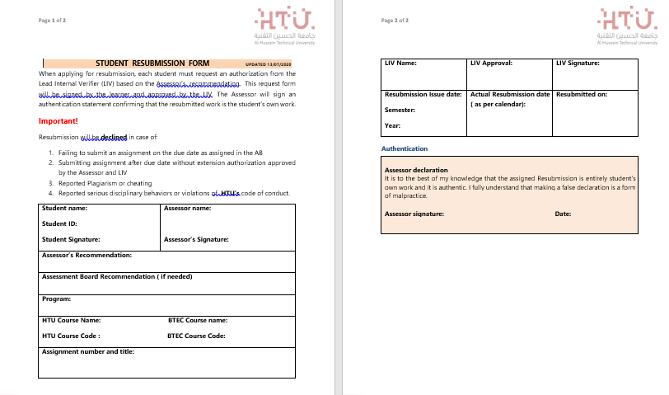

Slide 22
Formative assessment
Why is it important?
Formative assessment is an integral part of the BTEC assessment process, involving both the Assessor and the Student in a two-way conversation about their Progress.
It takes place prior to summative assessment and does not confirm achievement of grades, but focuses on helping the student to reflect on their learning and improve their performance.
The main function of formative assessment is to provide feedback to enable the student to make improvements to consolidate a Pass, or attain a higher grade.
Must not coach students with specific advice on what to do for summative assessment
Formative assessment should use the COMMAND/VERBS from assessment criteria to help students understand achievement/progress and how to move forward.
The informal verbal feedback process is an ongoing process, however, it is good practice to have at least one formal written formative assessment feedback..
This feedback should be prompt and meaningful allowing sufficient time following the feedback for ACTION to improve the learner’s performance.

Slide 23
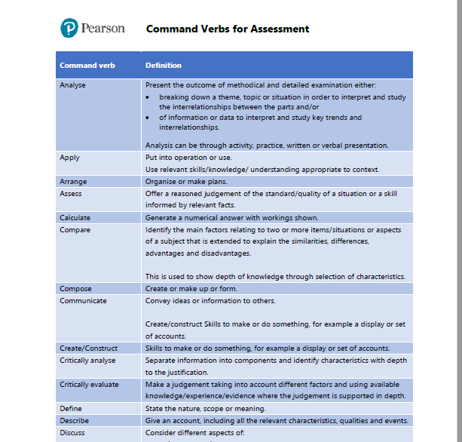
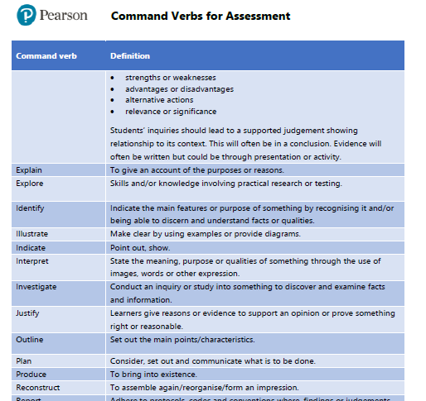
COMMAND VERBS FOR ASSESSMENT

Slide 24
Forms of Evidence for Assessment
Planning Documents
Case Studies
Project
Oral/Viva
Recorded Discussion
Reports
Performance
Peer Review
Log Books, Diaries, etc.
Written Investigation
Essay/Dissertation
Discussion Forum
Artefacts
Blog/e-Journal
Independent Research
Examination
Presentation Handouts, etc.
Role-play
Time-constrained Assessment
Work-based Learning
Witness Statements
Annotated Photographs
Self-reflection
Multiple Choice
Fill in the Blanks

Slide 25
Summative feedback & assessment
Summative assessment is the Final Consideration by an Assessor of a student's assignment, agreeing which assessment criteria the student has met in the assignment and recording those decisions.
Students are not offered opportunities to revisit assignments at this stage of the assessment process.

Slide 26
Learning Outcomes and Assessment Criteria
Pass | Merit | Distinction
LO1 Explain server technologies and management services associated with hosting and managing websites
P1 Identify the purpose and types of DNS, including explanations on how domain names are organised and managed. P2 Explain the purpose and relationships between communication protocols, server hardware, operating systems and web server software with regards to designing, publishing and accessing a website. | M1 Evaluate the impact of common web development technologies and frameworks with regards to website design, functionality and management. M2 Review the influence of search engines on website performance and provide evidence-based support for improving a site’s index value and rank through search engine optimisation. | LO1 & LO2 D1 Justify the tools and techniques chosen to realise a custom built website.
LO2 Categorise website technologies, tools and software used to develop websites
P3 Discuss the capabilities and relationships between front-end and back-end website technologies and explain how these relate to presentation and application layers. P4 Discuss the differences between online website creation tools and custom built sites with regards to design flexibility, performance, functionality, User Experience (UX) and User Interface (UI). | M3 Evaluate a range of tools and techniques available to design and develop a custom built website.
LO3 Utilise website technologies, tools and techniques with good design principles to create a multipage website
P5 Create a design document for a branded, multipage website supported with medium fidelity wireframes and a full set of client and user requirements. P6 Use your design document with appropriate principles, standards and guidelines to produce a branded, multipage website supported with realistic content. | M4 Compare and contrast the multipage website created to the design document. | D2 Critically evaluate the design and development process against your design document and analyse any technical challenges.
LO4 Create and use a Test Plan to review the performance and design of a multipage website
P7 Create a suitable Test Plan identifying key performance areas and use it to review the functionality and performance of your website. | M5 Evaluate the Quality Assurance (QA) process and review how it was implemented during your design and development stages. | D3 Critically evaluate the results of your Test Plan and include a review of the overall success of your multipage website; use this evaluation to explain any areas of success and provide justified recommendations for areas that require improvement.
Notes:
We can also use some of the other ‘key terms’ to help the student recognise the ‘critical’ things that they should consider when developing their work.
---
This approach to assignments encourages the student to analyse the brief to understand ways of attempting higher level achievement. It is also more in keeping with professional context.
In professional contexts, the brief is not presented as a series of ‘tasks’ (as assignments in the QCF would have done). Rather, an employer or a client states what they want, and it is part of the role of the professional to understand expectations of quality within the brief. So, this approach to assignment writing also provides the student with some additional skills development in understanding how to read and analyse a brief.
Use online chat to get delegates to discuss whether this is an approach that they can see working with their students.

Slide 27
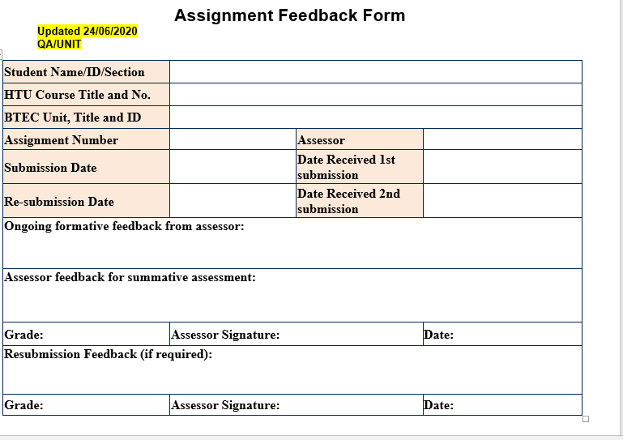
SUMMATIVE FEEDBACK TEMPLATE

Slide 28
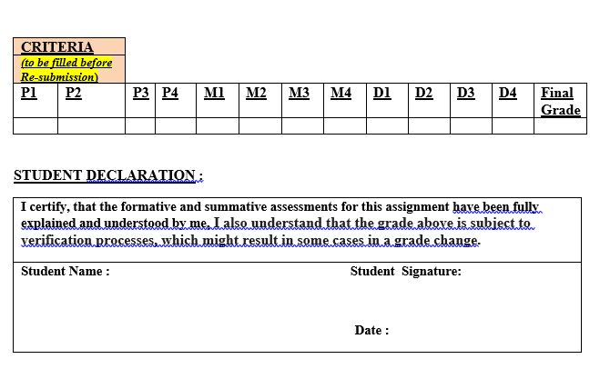

Slide 29
P l a g I a r I s m
The authentication of student evidence is the responsibility of the Centre.
If during external examination, the International Standard Verifier (ISV) raises concerns about the authenticity of evidence
The Centre will be required to investigate further. Depending on the outcomes, penalties may be applied.

Slide 30

Turnitin
One of the many e-learning tools that you will encounter in your academic journey is Turnitin.
This is a cross-checking software that can aid you in reducing unreferenced or lifted material by warning of similarities with work available on the internet or previously submitted onto our platform.

Slide 31
FOR SUPPORT AND GUIDANCE
VISIT THE
QULIATY ASSURANCE
UNIT
AT 411 MAIN-2
Notes:
Using the handout, have the delegates work in subject-related groups to develop a vocational scenario for a unit of their choice. Have a couple of groups share their scenario and get the rest of the group to comment on its appropriateness. Does it give the student a clear role, at the appropriate level? Does it give a relevant and up-to-date context? Is the overall presented clearly?

Slide 32

Thank You

